Slide 1
Database
Management Systems
Lecture - 2

Slide 2
Lecture Overview
Database Architecture
Data Independence

Slide 3
Database Architecture

Slide 4
Three Level Architecture
A basis for understanding DBMS functionalities
Three levels at which data can be described

Slide 5
Objective
Separate users view from the physical representation
Why?
  Different views of same data
  Both ways easy change

Slide 6
The Three-Level Architecture
User 1
User 2
User n
External Level
View 1
View 2
View n
Conceptual Level
Conceptual Schema
Internal
Schema
Internal Level
Physical Data Organization
Database

Slide 7
Level 1
External View
The way users think about data

Slide 8
External View
Users may have different views of the same data e.g. date, time etc.

Slide 9
External View
Virtual/calculated data: that is not actually stored in the database but is created when needed e.g. age, statistical data etc.

Slide 10
External View
DBMS uses external views to create user interface for different users which is both the facility and barrier

Slide 11
External View
User’s external view is created after considering data access, reports, and the transactions needs.

Slide 12
External View
External schema evolves as user needs are modified over time

Slide 13


Employee Data
Workers
Saleema
First Name: Rana
Last Name: Aslam
Date of Birth:
12 Sep, 1970
Name: R. Aslam
Age: 25y,10d
Dept: Sales
Saleem
External Layer
Lower Layers

Slide 14
Level 2
Logical or Conceptual View
A complete description of the information content of the database

Slide 15
Conceptual Schema
The entire information structure of the database, as seen by the DBA
The community view of data

Slide 16
Conceptual Schema
All entities, attributes and their relationships are represented here

Slide 17
Conceptual Schema
Contains record types representing entities, data item types with their attributes, relationships and constraints on data.

Slide 18
Employee Data
Workers
Saleema
First Name: Rana
Last Name: Aslam
Date of Birth:
12 Sep, 1970
Name: R. Aslam
Age: 24y,10d
Dept: Sales
Saleem
External Layer
Logical Record Interface
Conceptual Layer
Name | DoB | Deps | DepId
Rana Aslam | 12/09/70 | 5 | D001
Marya Wasti | 29/02/80 | 0 | D005

Slide 19
Level 3
Internal or Physical View
Concerns about the physical implementation of the database

Slide 20
Internal View
DBMS chooses type of data structures
lays out data on storage devices with operating system access methods
Internal record: a single stored record
Does not just contain what we see at the conceptual level
DBMS adds other data

Slide 21
Physical Level
Generally same as Internal
Actual representation of data on the storage device
In the binary format
OS responsibility

Slide 22
Inter-Schema Mappings
Also a part of 3-level architecture
External/conceptual mapping
Conceptual/Internal

Slide 23
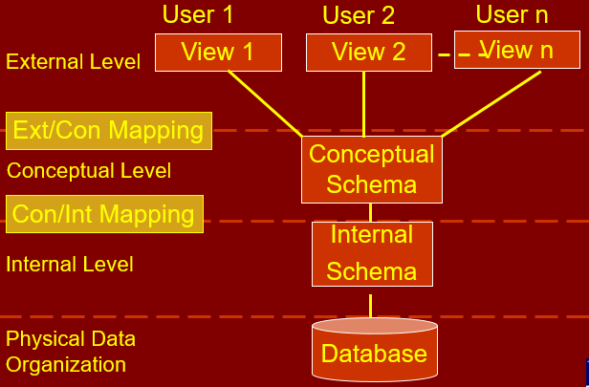
3-Level Architecture

Slide 24
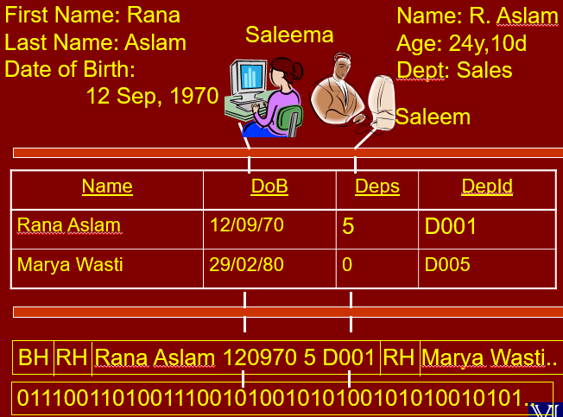

Slide 25
Data Independence

Slide 26
Data Independence
A major outcome of 3-L Arch
The immunity of applications to change in storage structure and access strategy
Changes in lower level do not affect the upper levels
Don’t take it word to word
Mind the direction

Slide 27
Data Independence Types
Logical Data Independence
Physical Data Independence

Slide 28
Logical Data Independence
Changes in conceptual model do not affect the external views
Immunity of external level from changes at conceptual level
Types of Changes
Adding a new file/index etc.
Adding a new field in a file
Changing type/size
Deleting an attribute

Slide 29
Physical Data Independence
Changes in the internal model do not affect the conceptual model
Immunity of Conceptual level from changes at Internal level
Types of Changes
Changing file organization
Index implementation, hash, tree etc.
Changing storage medium

Slide 30
Database
Management Systems
Lecture – 2
END

